Slide 1


Customer Satisfaction Amidst Utilities Post Covid-19
West Virginia State University – College of Natural Science & Mathematics
Bernadette Hoffman Vincent Smith M.S
IRB Approval:
WVSU-IRB-2021-2

Slide 2
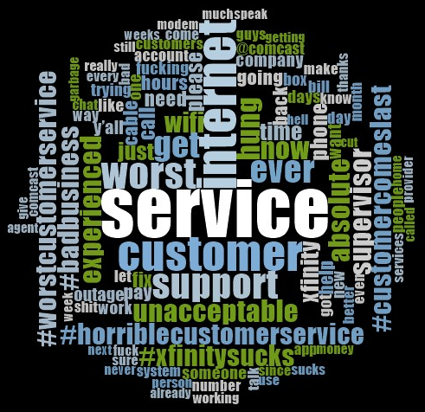
What if this was said about your company?

Slide 3
Why this research is important…
The pandemic has shaped the world we know (Ceylan et al., 2020). Those in rural areas have lived disconnected from others without access to internet (Nuechterlein & Shelanski, 2020). As a country we have faced unemployment, companies have gone under, and consumerism has shifted to online, generating the opening of countless online ventures (Donthu & Gustafsson, 2020). Grid demands drastically shifted from commercial to almost solely residential (Bielecki et al., 2021). Utility companies have struggled to meet the changing demands of their industries (Lai & Widmar, 2020). Moratoriums are ending across the country as some companies attempt to collect past due balances that can be into the thousands (Kowanko & Harak, 2021). Research has shown that customer satisfaction directly impacts future profitability (Bhattacharya et al., 2021). With developments in linguistics and machine learning, customer satisfaction can be analyzed using social media (Rathod et al., 2020).

Slide 4
Moratoriums?
Moratorium – the legal authorization established for a debtor to allow debts to collect without payment.
During our collection – 6 states ended their moratoriums on 3 separate days.
Determinations
Twitter as a data source – tweets are relatively small, businesses frequently use twitter, as do their customers.
Utility companies chosen – requirements, ability to observe the results by company.

Slide 5
Data Collection and Cleaning
Data was collected using Ncapture (a browser addon for the data analysis software NVivo). This was done on a weekly basis to ensure adequate amounts of data were collected.
The data was cleaned using Microsoft Excel and text mining packages in R using RStudio.
The sentiment analyses were ran using various R packages.
Each analysis gave us a sentiment score or polarity (a range of positive to negative) for each utility type. A higher polarity means higher customer satisfaction.
Data sets were compiled, and the data was then analyzed using IBM’s SPSS.

Slide 6
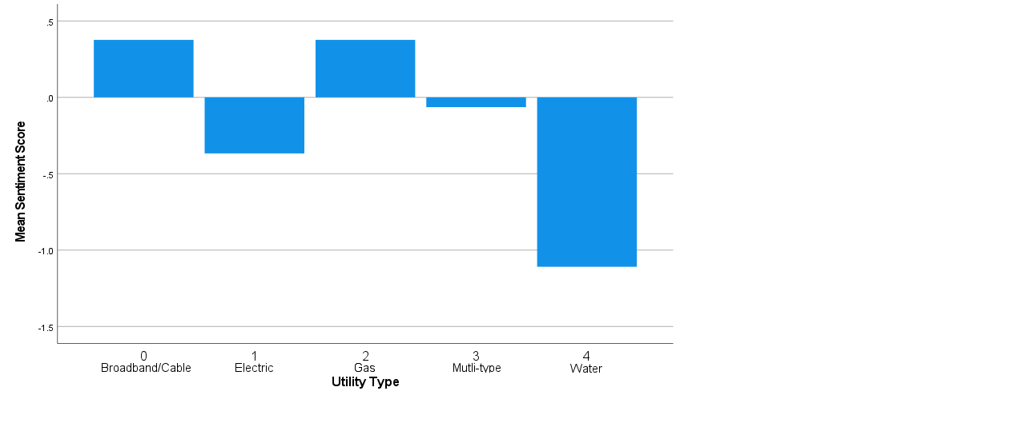
Results (ANOVA)
ANOVA – compares three or more components.
Used to compare each utility type by average polarity score.
Ranges from -1.11 to .38 in an overall range of -25 to 28.
Statistically significant, not practically significant.

Slide 7
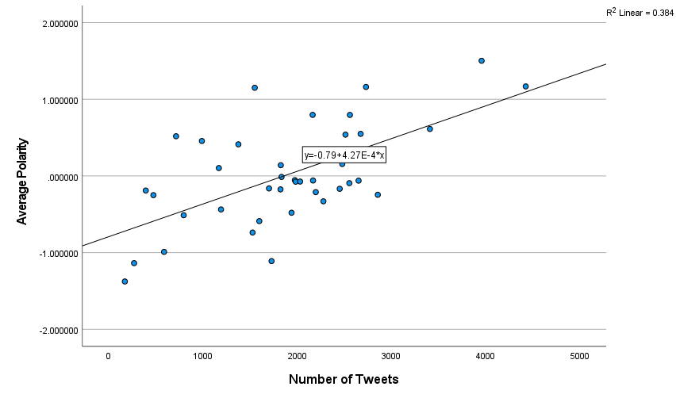
Results (Regression)
Linear Regression – analyzes the relationship between two components.
As the number of tweets increased, the polarity also increased.
A more positive sentiment for the utilities with a larger number of tweets.
Results contradictory to our hypothesis that more tweets = lower polarity.

Slide 8
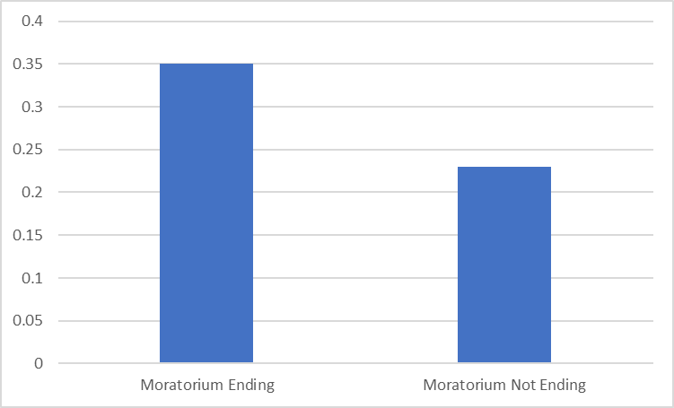
Results (T-Test)
T-tests – compares two or more components.
Conducted to measure surges in negative polarity coinciding with moratoriums ending.
Contradictory to our hypothesis the customer satisfaction was higher, though marginally so.

Slide 9
Conclusions Reached
The analyses showed that the water utilities fared the worst, though marginally so.
More social media activity, the better the data looked overall.
Quite possibly the moratorium endings were not acted on by some or many of the companies examined.
External events often shaped major trends in our data.
Positive tweets for cable involved Xfinity NASCAR races.
Negative water data reflects the severity of the drought in California.

Slide 10
Further research
The data posed more questions for further research such as (but not limited to):
How much do sponsored events really impact a customer's perception of a company?
Would the results have been different with a longer data collection period?
Is the overall customer satisfaction improving the further we get from this pandemic?

Slide 11
Acknowledgements and References
Many thanks are owed to:
Roger Estep
Karen Macon
Title III of the Higher Education Act of 1965
West Virginia Science & Research Higher Education Policy Commission
S.U.R.E Program
Due to the length of references on this project please send an email to bslack1@wvstateu.edu for a list of references.

